Slide 1



Digital portfolio
Student name: N.Jumana farveen
Reg.no:241341802522009
NMID:asanm41341324214010
/ 5197065D714A0CB9FA14B4291BCCAC25
Department:B.sc.cs
College: Deen college of arts and science nidur-kaduvangudi

Slide 2

student digital portfolio
01

Slide 3
Agenda
​●Problem Statement
​●Project Overview
​●End Users
​●Tools and Technologies
​●Portfolio Design and Layout
​●Features and Functionality
​●Results and Screenshots
​●Conclusion
​●Github Link
02

Slide 4
Problem Statement
​This portfolio solves the problem of presenting a student's skills and projects in a professional, online format, acting as a digital resume for potential employers.
03

Slide 5
project Overview
​This is a personal portfolio website for Jummana Farveen, a B.Sc. Computer Science student, designed to showcase her academic background, programming skills, and project work.
04

Slide 6

End users
​¤ Recruiters and hiring managers looking for junior developers or interns
​¤ Potential employers in the tech industry.
​¤ Academic professionals or mentors.
​¤ Collaborators or fellow students seeking to connect on projects.
05

Slide 7
Tools and Technologies
The portfolio and its featured projects utilize :
》HTML
》CSS
》PHP
》MySQL
》Java
》Python.
06

Slide 8
Portfolio Design and Layout
The site uses a simple, single-page layout with a header, navigation, and distinct sections for "About Me," "Projects," and "Contact." Projects are displayed in a card-based grid.
07

Slide 9
Features and Functionalities
Key features include a navigable menu, a detailed "About Me" section, project descriptions, and an interactive contact form for user communication.
08

Slide 10
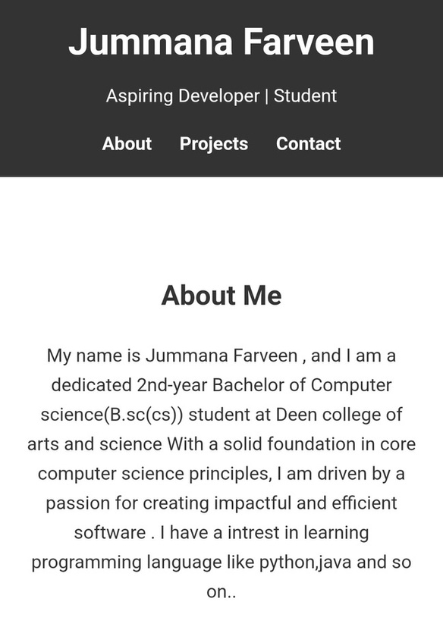
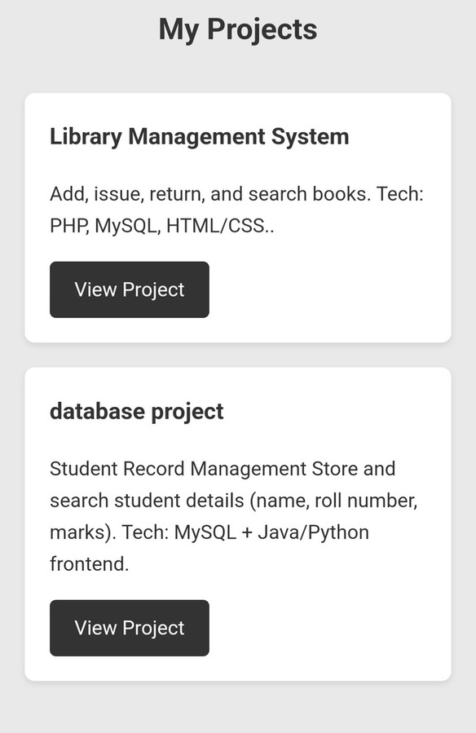
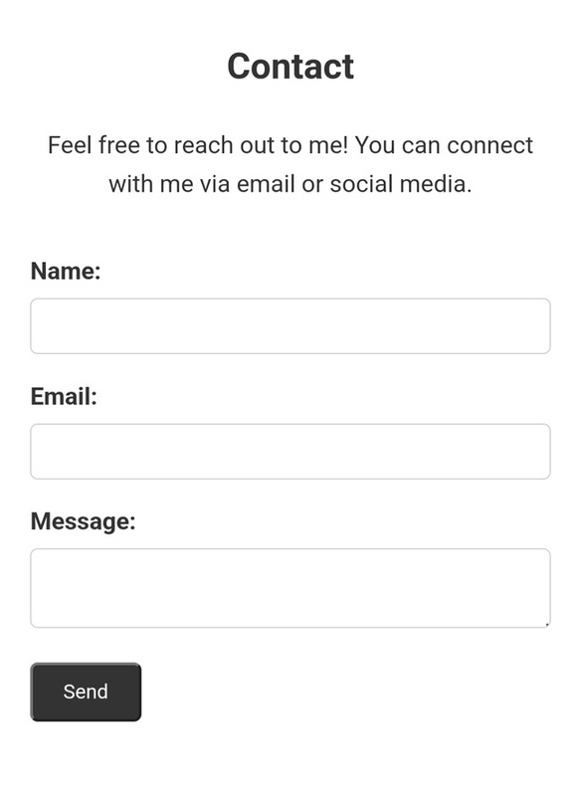
Results And Screenshots
09

Slide 11
Conclusion
Jummana Farveen's portfolio is a concise and effective tool for self-promotion, providing a clear overview of her skills and projects to advance her career.
10

Slide 12
Github link
https://github.com/dccs24jumana-cyber/Jumana-TNSDC-FWD-DP.git

